Slide 1
Health Economics
Chapter 2: Consumer Choice and Demand

Slide 2
Demand Price Elasticities
Good or Service | Price Elasticities
Hospital Care | -0.17 to -0.14
Physician Care | -0.35 to 0.16
Apples (U.S.) | -1.15
Bread (U.K.) | -0.26
Gas, Short Run (Canada) | -0.01 to -0.20
Cigarettes (U.S.) | -0.30 to -0.50
Beer (U.S.) | -0.20 to -0.40
Motion Picture Tickets | -3.40
Foreign Travel | -3.10
Folland, Goodman, and Stano (2007), p. 37

Slide 3
Market Elasticity vs. Firm Specific Elasticity
Dependent Variable | Price Elasticity Market
Physician visits with good health | -0.35
Physician visits with bad health | -0.16
Firm Specific
Dependent Variable | Price Elasticity for Individual Firm (e.g. a Doctor)
Physician Visits | -3.1 to -3.3
Hospital Services | -0.7 to -1.1
Nursing Homes | -3.5 to -3.9

Slide 4
Income Elasticities
Dependent Variable | Income Elasticity
All expenditures | 0.25 to 0.45
Hospital Services (admissions) | 0.02 to 0.04
Dental Services | 0.61 to 3.20
Physician Services (expenditures) | 0.22 to 0.85
Physician Services (visits) | 0.01 to 0.04
Folland, Goodman, and Stano (2007), p. 190

Slide 5
Demand Elasticities
Example: Suppose the price of a visit to the physician increases from $75 to $83.25 and that the demand for physician visits falls by 10%.
The average time cost of a visit remains the same at $40.

Slide 6
Insurance Elasticities
Plan | Likelihood of Any Use (%) | One or More Admissions (%) | Total Expenses (1991 $)
Free | 86.8 | 10.3 | 982
Family Pay 25% | 78.8 | 8.4 | 831
Family Pay 50% | 77.2 | 7.2 | 884
Family Pay 95% | 67.7 | 7.9 | 679
Individual Deductible | 72.3 | 9.6 | 797

Slide 7
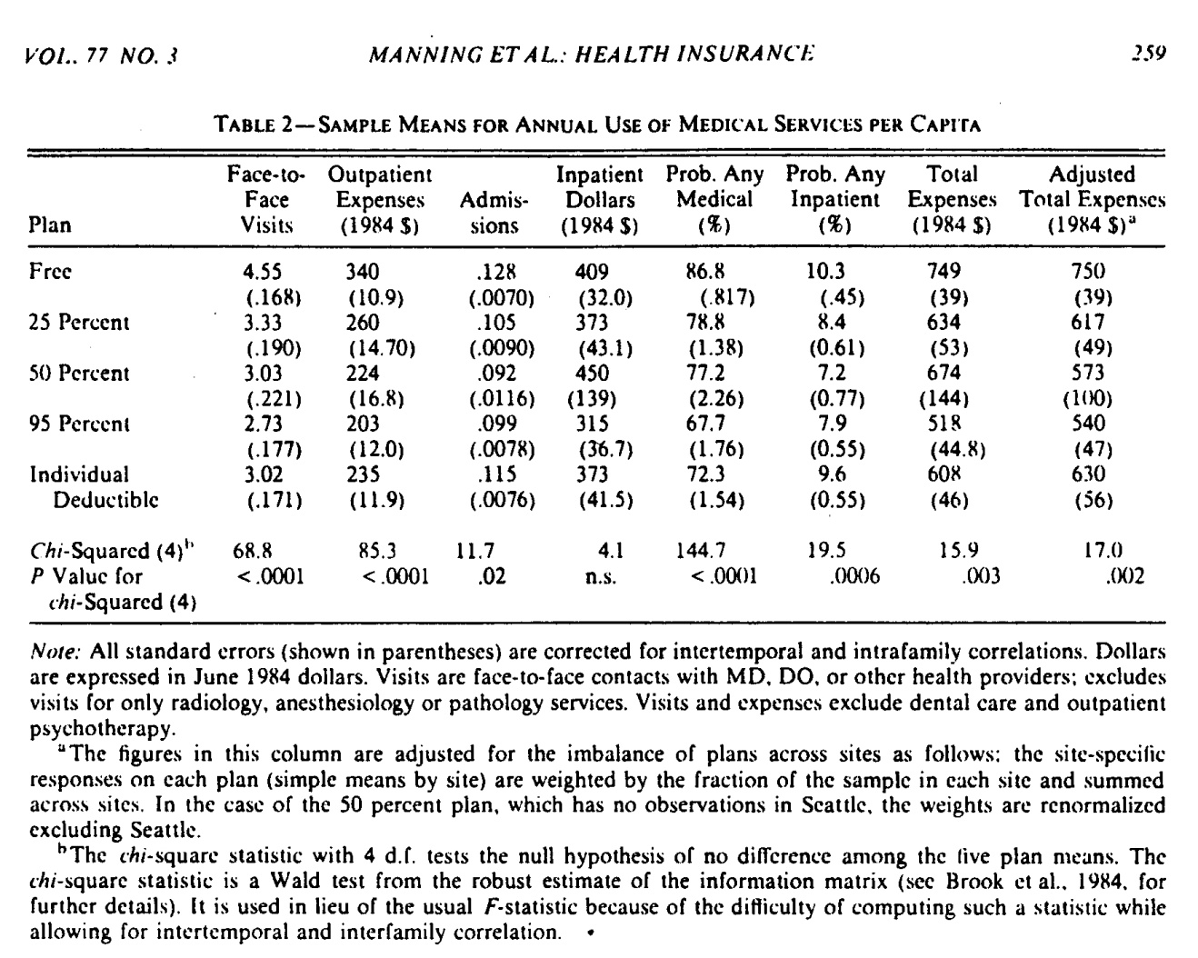

Slide 8
What Increased Health Expenditures
Since WWII→ 700% increase
Health insurance added 70% (according to RAND)
Increase in income (income tripled) added 60%
That is a total of 130% out of 700% comes from insurance and income increase
What about the rest?

